Slide 1
Conversational Recommender System for Restaurants
Hafsa Chaudhry, Omar Agha Khan, Hetvi Patel, and Sarah Denlinger

Slide 2
Introduction
GitHub: https://github.com/ihetvipatel/DATA-606-Capstone-Project-Conversational-Recommender-System-for-Restaurants
More than 178 million people visit Yelp every month across its platforms (Yaramova, 2023).
Since Yelp is used by so many people, Yelp reviews could be useful in recommending restaurants to users.
The goal of this project is to create a conversational recommender system to suggest restaurants to users.
This type of recommendation system is integrated into a chatbot and uses natural language processing (NLP) and machine learning techniques to make recommendations in a conversational manner.
Notes:
hafsa

Slide 3
Past Approaches
Authors Elham Asani , Hamed Vahdat-Nejad , and Javad Sadri built a context-aware recommender system based off of a user’s food review with 92.8% accuracy. The authors used sentiment analysis to gather the user’s sentiment on certain foods and used cosine similarity to compare their preferences to the menus of restaurants in their location (Asani et al., 2021).
Another approach was done by
Notes:
Sarah

Slide 4
Dataset Overview
This dataset was obtained from Yelp’s Open Dataset website (https://www.yelp.com/dataset)
6,990,280 reviews
150,346 businesses
200,100 pictures
11 metropolitan areas across 4 countries
908,915 tips by 1,987,897 users
Over 1.2 million attributes such as hours, parking, availability, and ambience
The reviewer's name, the date of the review, the rating given by the reviewer, and the text of the review are also included
Notes:
Sarah

Slide 5
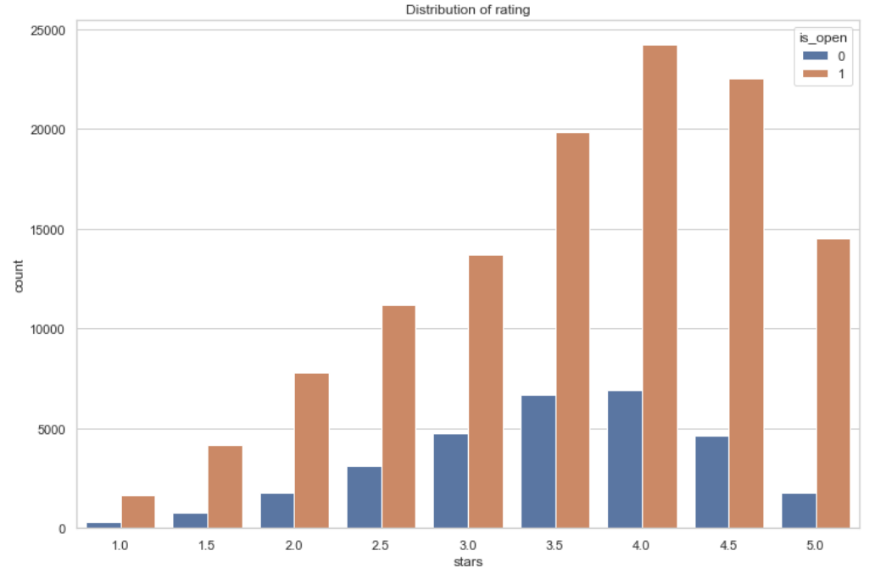
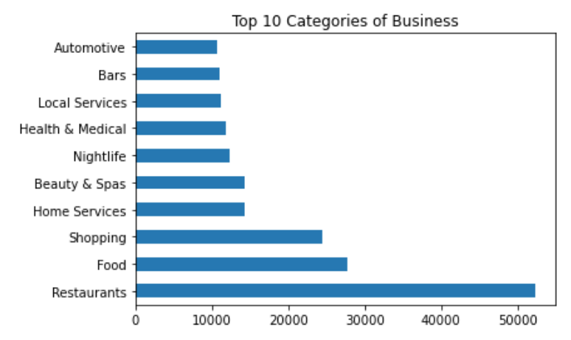
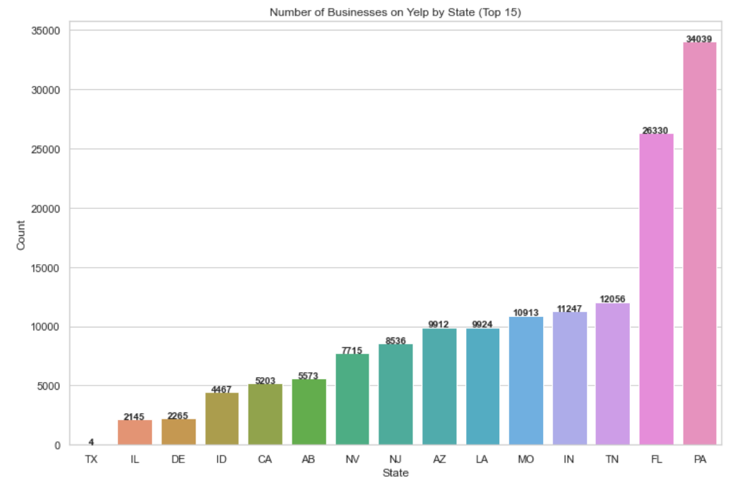
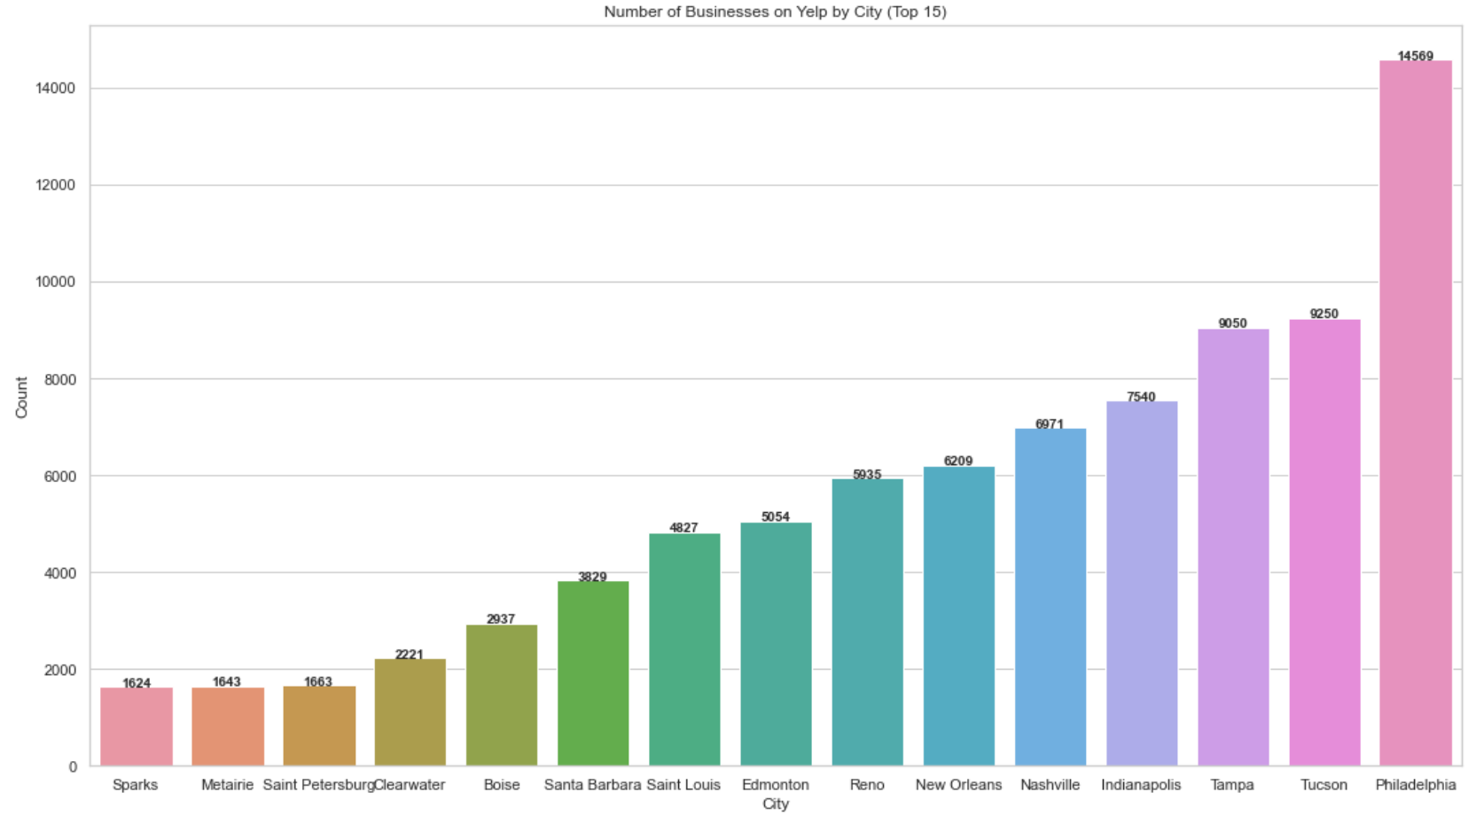
Exploratory Data Analysis (EDA)
150,346 businesses
Notes:
Hetvi
150,346 businesses
Most businesses that were opened received 4 star ratings
Most popular category is restaurants (sit down) and followed by food (could be food trucks or pop-ups)

Slide 6
Our approach to this project:
Pre-processing the data: Clean and prepare the restaurant review data for analysis.
Sentiment Analysis: Determine the overall sentiment (positive, negative, or neutral) of each review.
Text Classification: Classify the reviews into categories based on their content, such as food quality, service quality, atmosphere, etc.
Keyword Extraction: Extract the most frequently mentioned keywords in the reviews to determine the topics being discussed.
Recommendation Engine: Use the results of the sentiment analysis, text classification, and keyword extraction to build a recommendation engine that can suggest restaurants to users based on their preferences and opinions.
Notes:
Hetvi

Slide 7
Evaluation Metrics
For sentiment analysis, the performance evaluation metric could be the accuracy of the sentiment analysis results.
For text classification, the performance evaluation metric could be the F1-score, which is a measure of the accuracy of the classifier.
For the recommendation engine, the performance evaluation metric could be the Mean Average Precision (MAP), which measures the average precision of the recommendations made by the engine.

Slide 8
Chatbot Integration
Create a chatbot that can engage in natural language conversations with users and make recommendations based on the results of the recommendation engine.
The chatbot can ask questions to gather information about the user's preferences and use that information to make recommendations.
For example, the chatbot might ask questions like "Are you in the mood for Italian food?" or "Do you prefer fine dining or casual dining?"
Based on the user's answers, the chatbot can use the recommendation engine to suggest restaurants that match the user's preferences.
User preferences include distance from user’s location, reviews, and cuisine.
The chatbot can then provide the user with additional information about the recommended restaurants, such as their restaurant rating, locations, menus, and hours of operation.

Slide 9
References
Yaramova, S. (2023, January 30). 25 curious yelp statistics to show how big it is in 2023. Techjury. Retrieved February 20, 2023, from https://techjury.net/blog/yelp-statistics/#gref
Asani, E., Vahdat-Nejad, H., &amp; Sadri, J. (2021). Restaurant Recommender System based on sentiment analysis. Machine Learning with Applications, 6(100114). https://doi.org/10.1016/j.mlwa.2021.100114

